Slide 1
Retail Sales & Business Performance Analytics
Project demonstration — dataset is synthetic
Week 6 Final Data Analytics Capstone
Python • Pandas • EDA • Visualizations • Power BI • GitHub

Slide 2
Problem Statement
Retail teams need a consistent view of sales, profit, order volume, product mix, and regional demand.
Goal: clean transaction data, find patterns, and communicate actionable insights.
Deliverable: reproducible analysis plus a Power BI dashboard implementation plan.

Slide 3
Dataset & Tools
Raw records: 1,203; cleaned records: 1,190.
Fields include order date, region, category, product, quantity, price, discount, sales, profit, segment, and payment method.
Tools: Python, Pandas, NumPy, Matplotlib, Seaborn, Jupyter, Power BI Desktop, Git, GitHub.
Important: dataset is synthetic for demonstration, not real business data.

Slide 4
Data Preparation
Inspected schema, data types, missing values, and duplicates.
Removed duplicate records and invalid quantity/discount/price rows.
Imputed categorical nulls with mode and missing unit prices with median.
Recomputed sales using price × quantity × (1 − discount); imputed missing profit using category margin.

Slide 5
Key Performance Indicators
Generic currency units; synthetic data
Total Sales: 480,580.26
Total Profit: 178,868.70
Distinct Orders: 1,190
Units Sold: 3,194
Aggregate Profit Margin: 37.22%

Slide 6
Visualization Gallery
Monthly sales trend — seasonality pattern in generated data.
Category and regional sales — compare mix and geography.
Top 10 products — identify sales concentration.
Sales vs profit scatter and correlation heatmap — explore relationships.
Customer segment sales — compare segments.

Slide 7
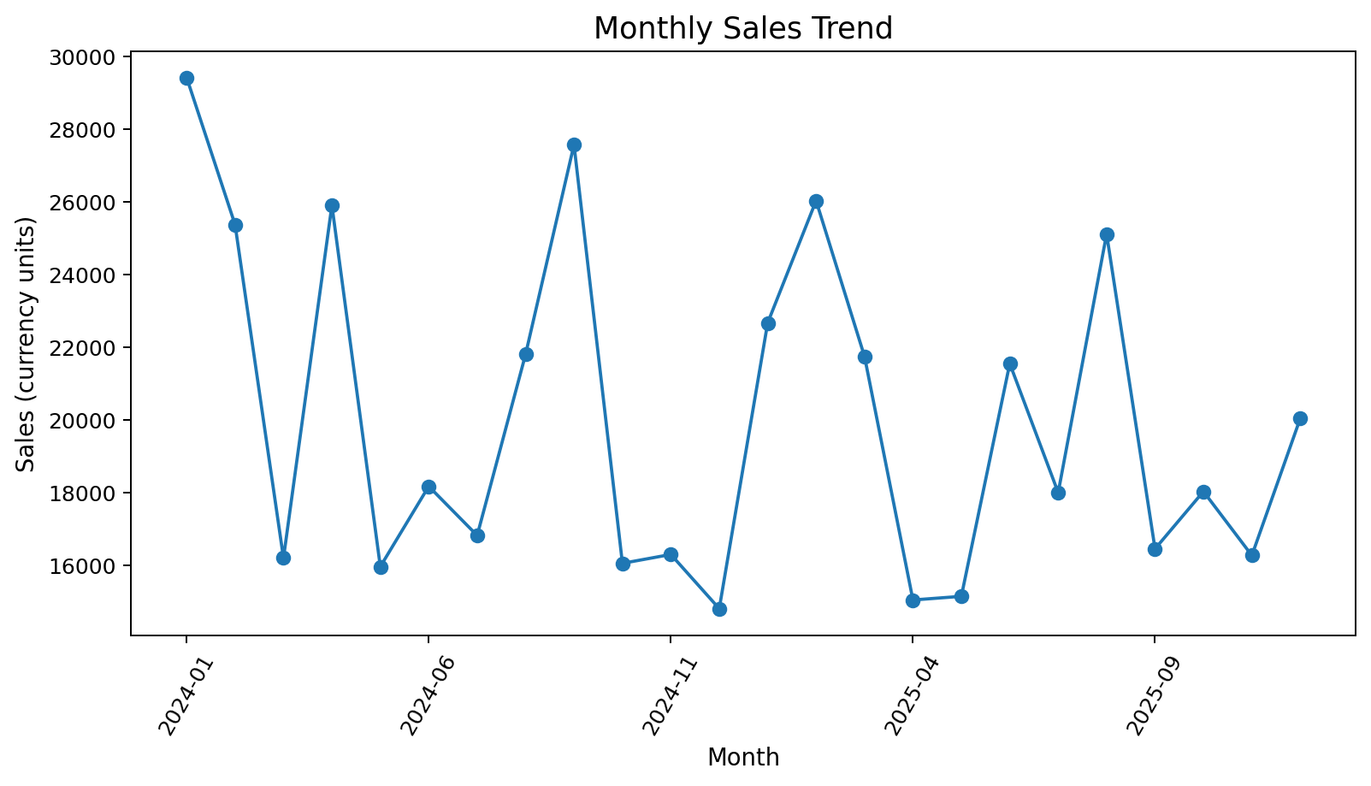
Monthly Sales

Slide 8
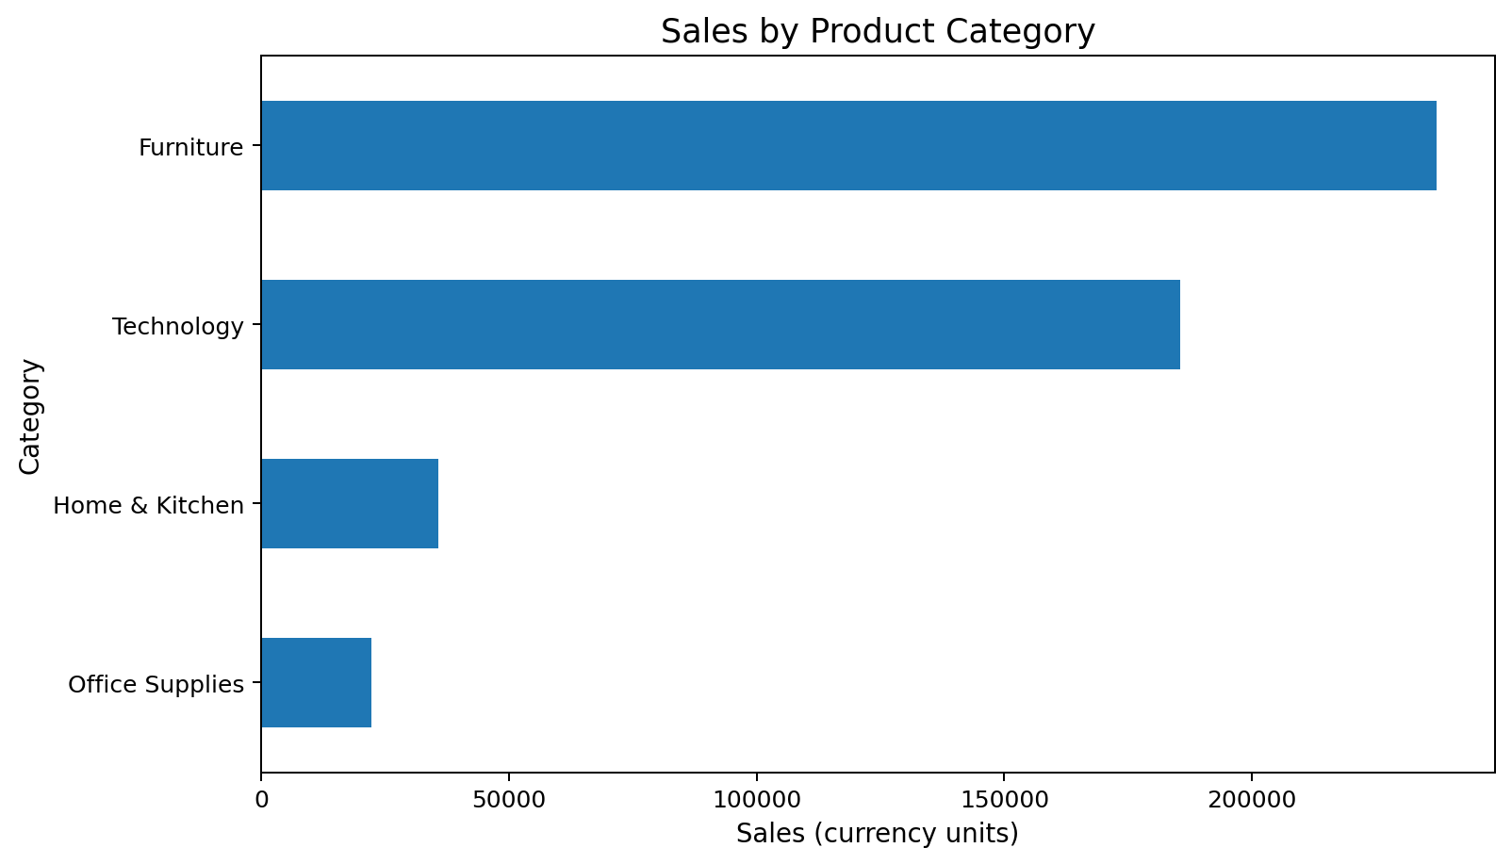
Category Sales

Slide 9
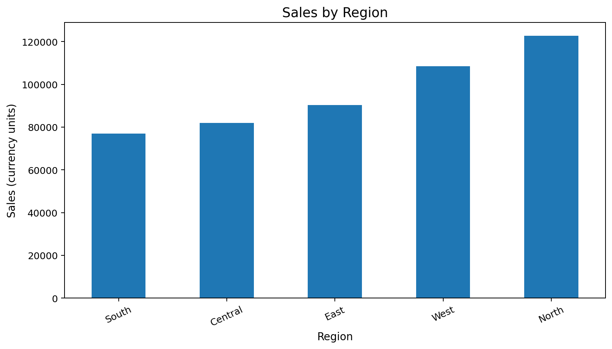
Regional Sales

Slide 10
Business Insights
Highest-sales category: Furniture.
Highest-sales region: North.
Highest-sales product: Desk.
Category margins differ: highest Office Supplies; lowest Technology.
Top sales month: 2024-01; lowest: 2024-12.
All results are illustrative because the dataset is synthetic.

Slide 11
Recommendations
Plan replenishment and campaigns using monthly/category/region trends, then validate with inventory and stockout data.
Track discounts with profit margin; optimize promotions for incremental profit rather than revenue alone.
Review product margin, returns, and holding costs before assortment decisions.
Normalize regional performance by stores, customers, and marketing spend when available.

Slide 12
Power BI Dashboard Plan
KPI cards: Total Sales, Total Profit, Total Orders, Profit Margin %.
Charts: monthly sales line, category sales/profit, regional sales, top products, customer segment mix.
Slicers: date, region, category, customer segment, payment method.
DAX measures and build guide are included. Create the .pbix in Power BI Desktop; it is not precompiled in this package.

Slide 13
GitHub & Submission Checklist
Create an empty GitHub repository and clone it.
Add the project files and make 3 meaningful commits.
Push and verify with git status and git log --oneline.
Before final submission: build the Power BI .pbix; if required, replace synthetic data with a cited real dataset and rerun all analysis.

Slide 14
Conclusion
The package provides code, dataset, notebook, seven charts, report, presentation, README, DAX measures, and Git workflow instructions.
Limitations: synthetic data, generic currency, no compiled .pbix.
Thank you — questions?

